Slide 1
Javascript-Behind the scence

Slide 2
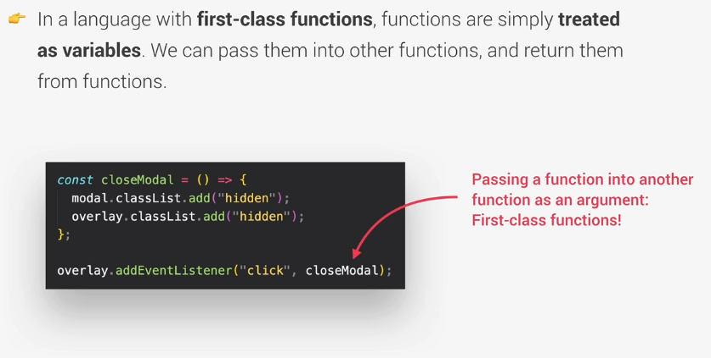
First-class-Function

Slide 3
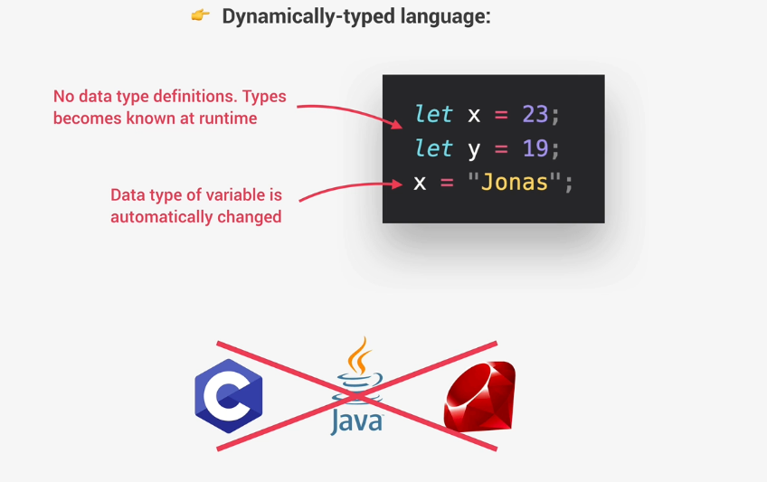
Dynamic

Slide 4
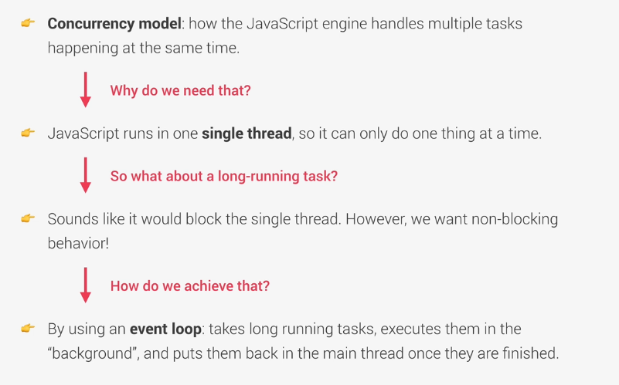
Single Threaded And Non-blocking Event loop

Slide 5
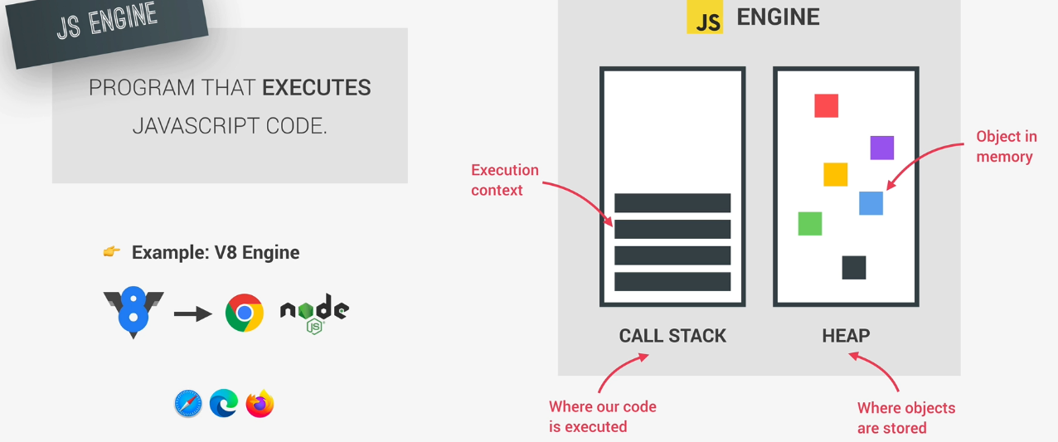
Javascript Engine

Slide 6
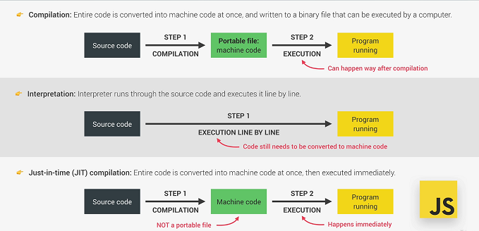
Compilation And Interpretation

Slide 7
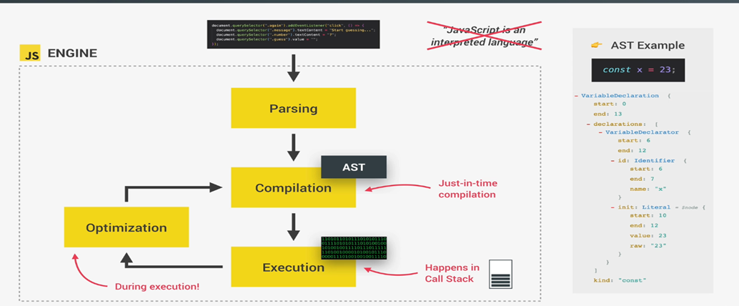
Compilation of javascript

Slide 8
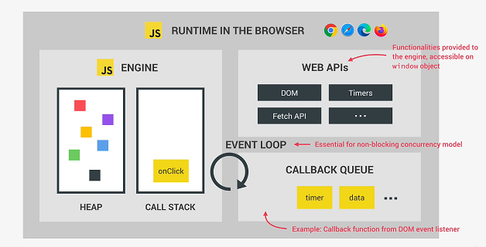
Javascript Runtime

Slide 9
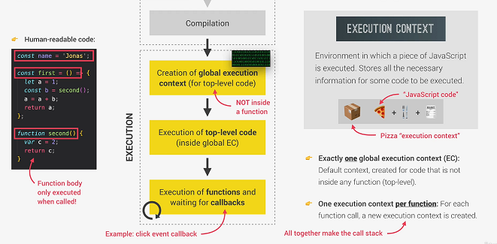
Execution Context

Slide 10
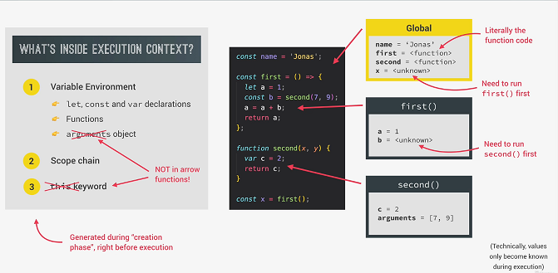
Execution Context

Slide 11
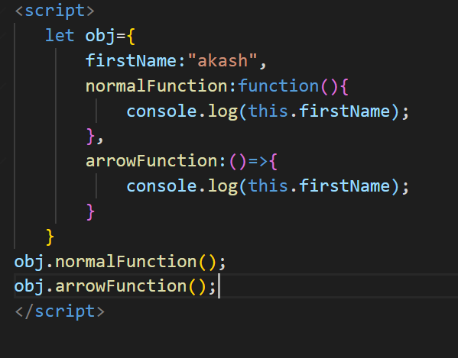
Normal function and arrow function

Slide 12
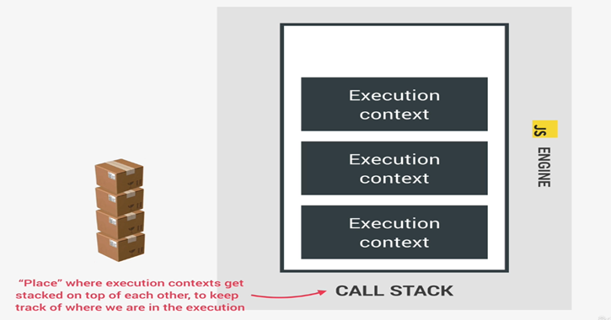
Execution Context – Call Stack

Slide 13
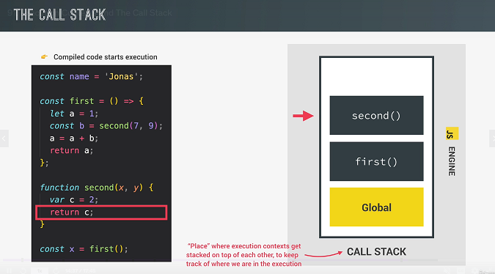
Execution Context : call stack - 1

Slide 14
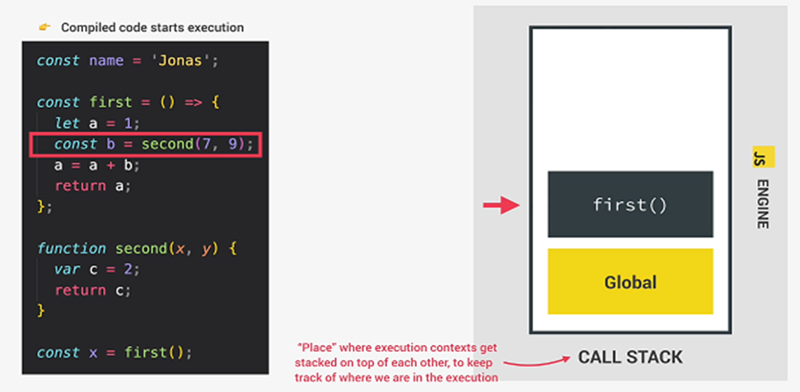
Execution Context : call stack - 2

Slide 15
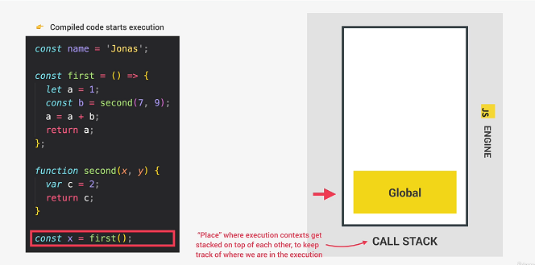
Execution Context : call stack - 3

Slide 16
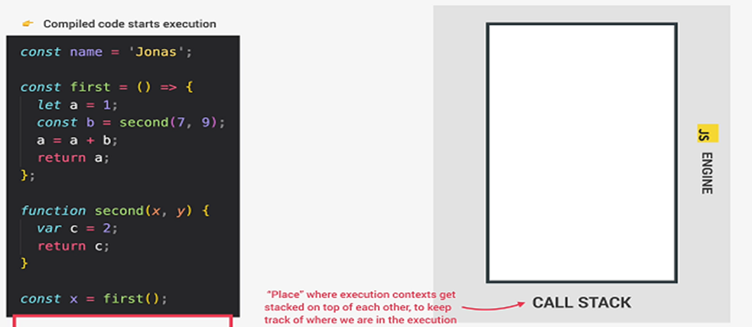
Execution Context : call stack - 4

